Slide 1
Object segmentation for Stretch 3 Robot Using SAM2
Under Prof. Vrijendra Singh
Group Members:
Abhinay karade (IIT2022170)
Sachin Sarkar (IIT2022192)
Sambhav Sinha (IIT2022194)
Vinjamury Jayant(IIT2022218)
Dinesh Pradhan (IIT2022219)

Slide 2
INTRODUCTION :
This project focuses on the integration of SAM 2 (Segment Anything Model) for advanced image segmentation tasks in the Stretch3 robot system, aiming to improve its object recognition capability.
SAM 2 is a versatile model known for its zero-shot segmentation and ability to handle diverse and complex environments.
Enhancing its visual perception and object manipulation capabilities

Slide 3
Objective :
To integrate SAM 2 into the Stretch3 robot system to enhance its object recognition capability, improving its ability to interact effectively with complex and dynamic environments.

Slide 4
Proposed Work :
Seamless Integration: Establish a robust communication pipeline between the Stretch3 system and SAM 2 to enable real-time image segmentation.
Domain-Specific Fine-Tuning: Fine-tune SAM 2 using domain-specific datasets, such as LabPicsV1 for chemistry lab environments and BRAIN-TUMOR.v1i for medical imaging tasks, to test its performance in specialized scenarios.
Performance Comparison: Evaluate SAM 2 against an alternative model, the YOLOv11, specifically for segmentation tasks, and document the comparative results.

Slide 5
Proposed Work :
Optimization: Address software and hardware compatibility issues, including version conflicts between pyrealsense2 and SAM 2 and GPU constraints , to facilitate working and improve overall system efficiency
Future Enhancements: Explore the potential integration of SAM 2 with Stretch3's grid-based object identification and YOLO frameworks to achieve a more comprehensive understanding of its surroundings.

Slide 6
SAM 2 :
Segment Anything Model 2
Advanced computer vision model
SAM 2 over SAM
More accurate
Faster
Works on videos

Slide 7
Key Features of SAM 2:
Image Encoder for Feature Extraction
Memory Attention Mechanism
Dynamic Memory Bank
Interactive Prompted Frames

Slide 8
Enhancing Segmentation Precision in SAM 2:
Input Points and Class Labels
Bounding Box Coordinates
Labeling Points
Refinement of Segmentation

Slide 9
Applications:
Video Editing and Robotics - video editing , background removal , robotics for autonomous navigation , object interaction.
Medical Imaging - such as tumor segmentation
Remote Sensing - detecting features in satellite Imagery , identifying objects in complex and vast environments.
Motion Segmentation - track moving objects in videos, action recognition , video editing.

Slide 10
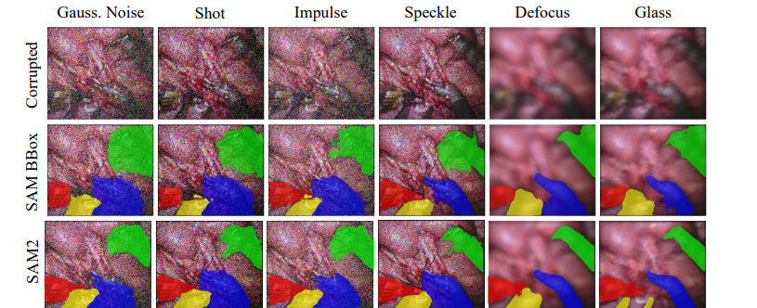
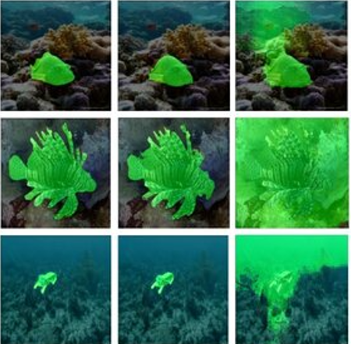
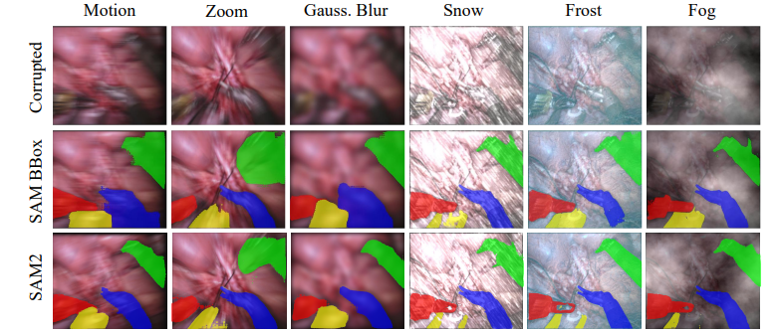
Applications:
Robust to noise
Underwater segmentation

Slide 11
Related works:
Image segmentation - MobileSAM , medical imaging ,
remote sensing , motion segmentation
Interactive Video Object Segmentation (iVOS) - Video trackers based on masks or points
Semi-supervised Video Object Segmentation (VOS) - Online fine-tuning on the first video frame or on all frames.
Medical sam 2: Segment medical images as video via segment anything model 2.
Biomedical sam 2: Segment anything in biomedical images and videos.

Slide 12
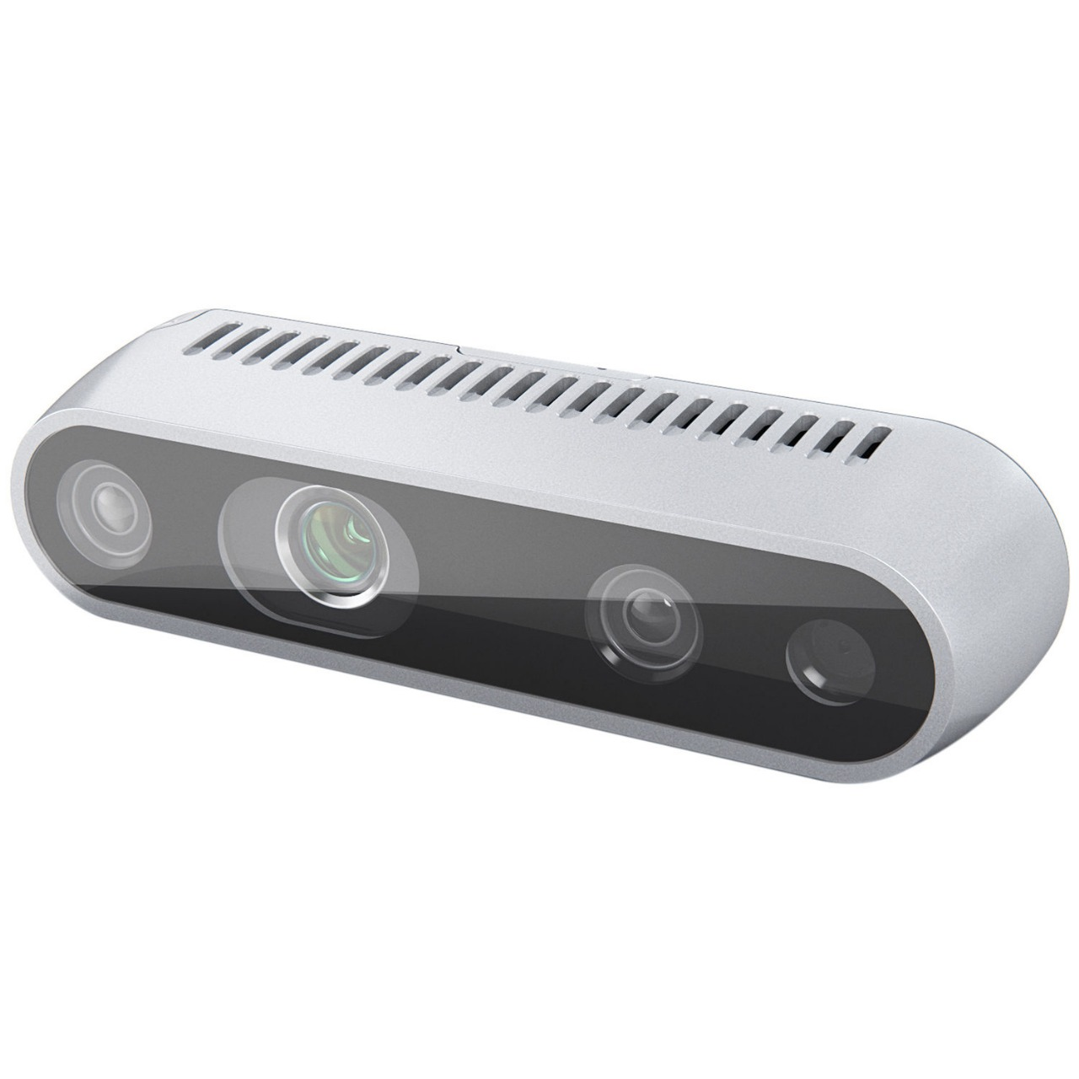
Intel Real-sense D435i :
Advanced Depth Sensing: Generates high-resolution depth maps using stereo vision, enabling precise 3D perception for tasks like robotic navigation and object segmentation.
Robust Design and Versatility: Features a wide field of view (85° x 58°) and a high-quality RGB camera, ideal for complex environments and seamless integration with Stretch 3.

Slide 13
Pyrealsense2 Package:
Stream Configuration: The pyrealsense2 library was used to initialize the D435i camera, configure depth and RGB streams, and synchronize them for accurate data capture.
Preprocessing for Segmentation: Captured images were preprocessed to enhance quality before feeding them to SAM 2 for precise object segmentation.

Slide 14
Training on Custom Dataset
LabPics1 Dataset: Encompassing 7,900 diverse annotated images, LabPics1 captures complex chemistry lab setups, providing a challenging benchmark for segmentation models to handle varying object sizes, shapes, and intricate details effectively.
Brain Tumor v1 Dataset: Comprising 1,672 annotated 640x640 images, this dataset emphasizes precision, focusing on identifying and segmenting irregularly shaped brain tumors in medical imaging tasks.

Slide 15
Results of training
LabPics1 Chemistry Dataset: Fine-tuning SAM 2 alone on the LabPics1 dataset resulted in an IoU score of 0.6237, further showing its capability to adapt and excel in specialized tasks where YOLO v11 lagged which gives a IOU score of 0.5698.
Brain Tumor Dataset Performance: On the brain tumor dataset, SAM 2 achieved an IoU score of 0.7018, outperforming YOLO v11's 0.6503, demonstrating higher segmentation accuracy.

Slide 16
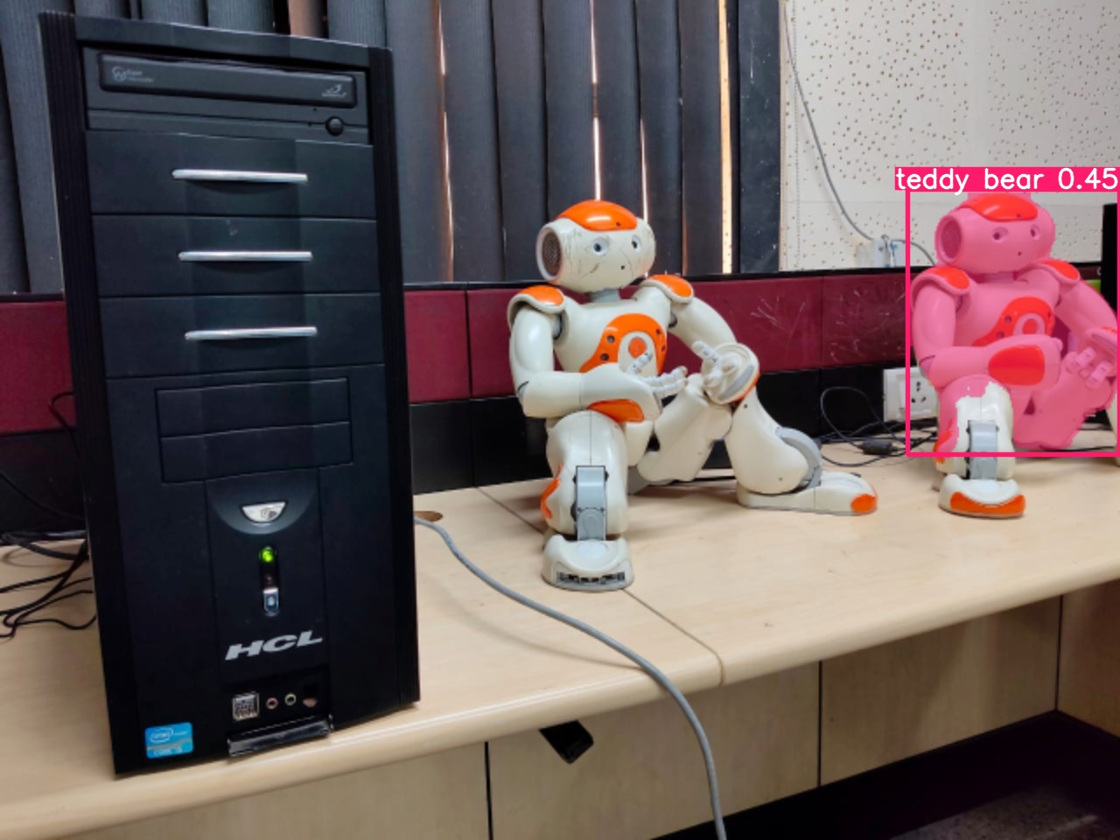
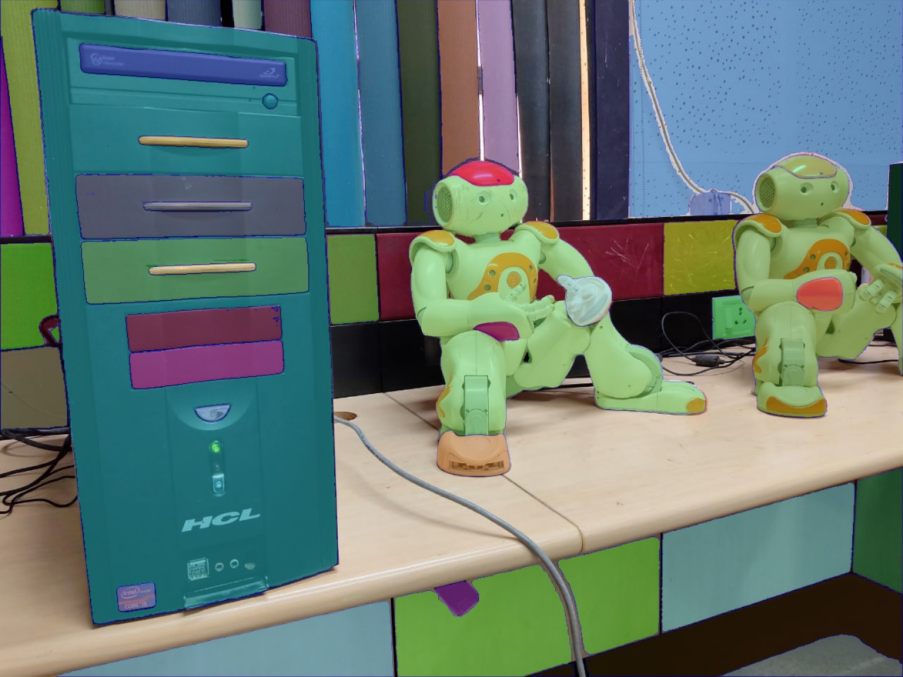
Visual Comparison
YOLO v11
SAM2

Slide 17
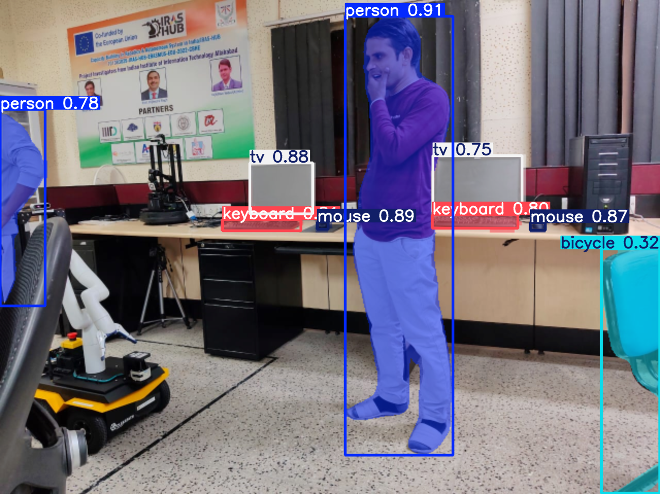
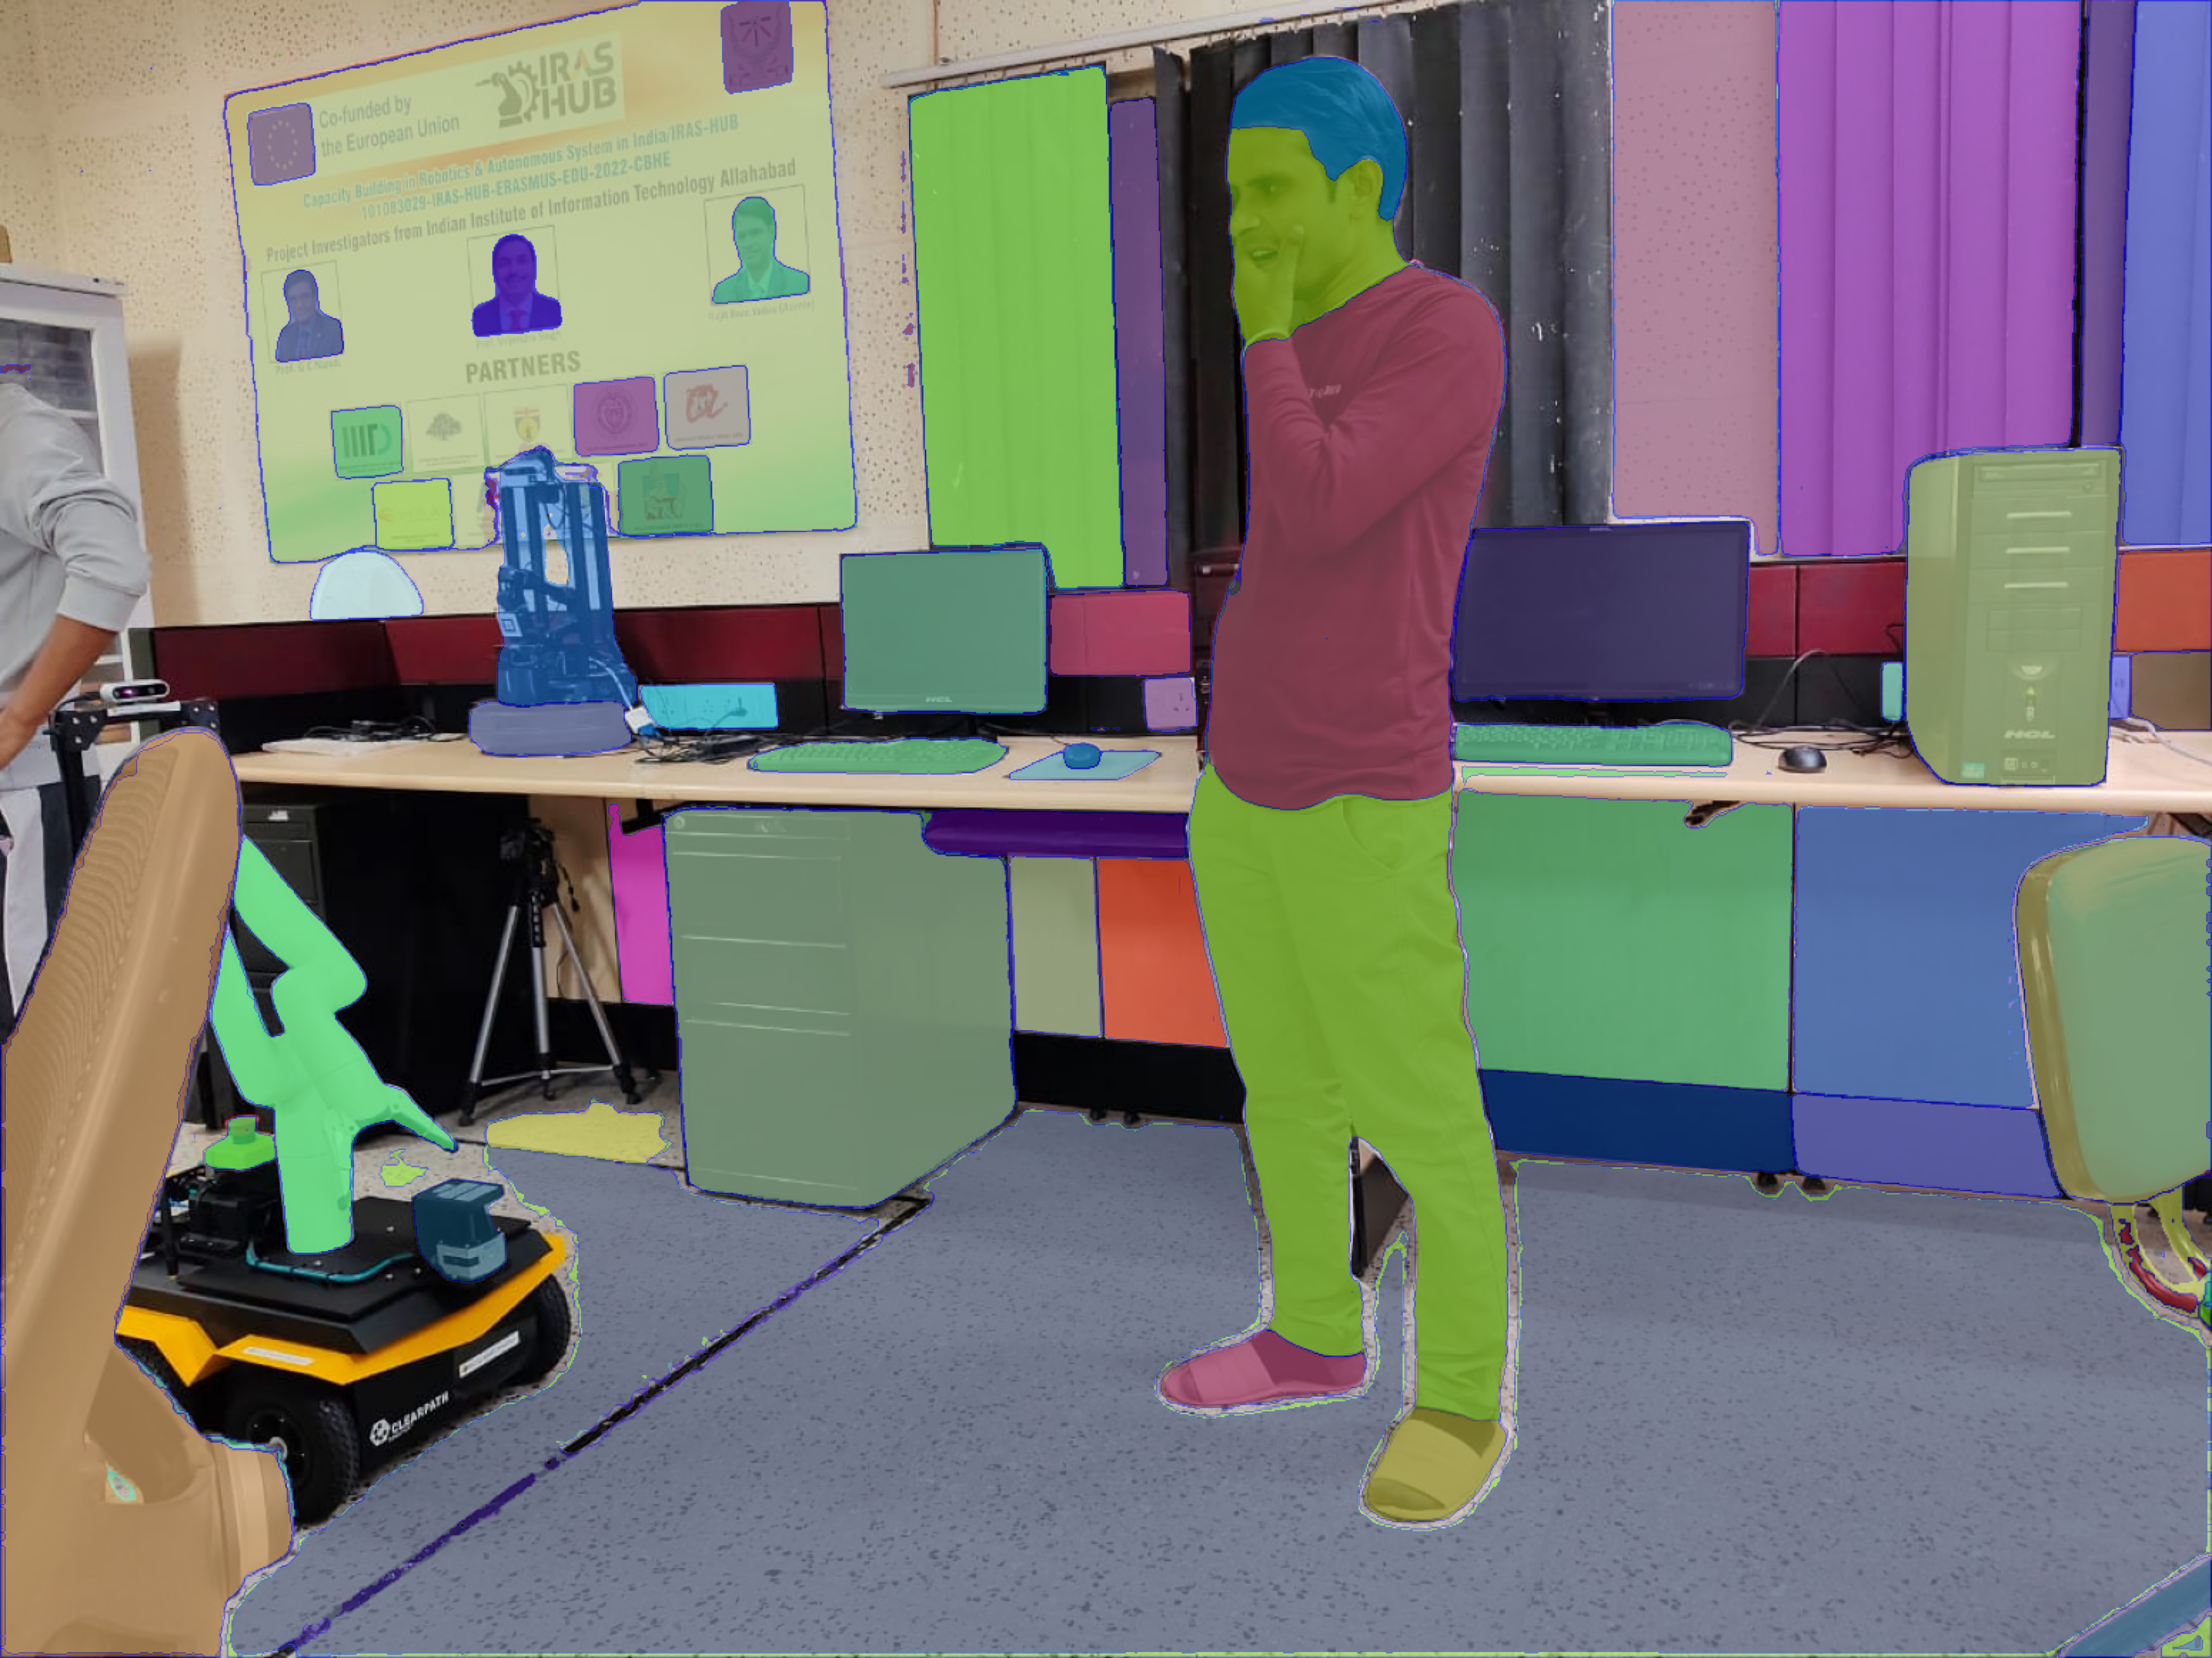
Visual Comparison
YOLO v11
SAM2

Slide 18
Challenges:
Compatibility Issue:
• The pyrealsense2 library, required for interfacing with the Intel RealSense
D435i camera, supports only Python versions 3.9 or lower.
• In contrast, SAM 2 requires dependencies compatible with Python 3.10 or higher.
Processing Speed: SAM 2 is faster only when GPU need of 8 GB – 12 GB is fulfilled. Our system’s 4 GB GPU imposed limitations on processing speed, leading to an average inference time of 2–3 seconds per image.

Slide 19
Solutions:
We created separate Python environments and a parent program to execute pyrealsense2 (Python 3.9) and SAM 2 (Python 3.12) together.
The 4 GB GPU limited processing speed, causing 2–3 seconds per image inference. Upgrading to better hardware can improve performance.

Slide 20
Future Work:
Integrate YOLO and SAM 2 on Stretch 3 for enhanced object detection and segmentation.
Improve object manipulation for robotic tasks.
Refine YOLO's bounding boxes using SAM 2's segmentation masks..
Extend capabilities to handle complex, cluttered scenes with overlapping objects.

Slide 21
Conclusion:
Enhanced Segmentation Precision of SAM 2: SAM 2 significantly improves segmentation accuracy for irregular, overlapping, and complex objects.
Comparative Superiority: Despite higher computational demands, SAM 2 outperforms YOLO in flexibility, accuracy, and robustness, making it a preferred choice.
We should use the high performance of SAM 2 for stretch 3 robot in order to do better object manipulation and navigation.

Slide 22
References:
1) https://hello-robot.com/stretch-3-product
2) https://hello-robot.com/
3) https://github.com/hello-robot B. SAM 2
4) https://ai.meta.com/sam2/
5) https://segment-anything.com/
6) https://github.com/facebookresearch/segment-anything
7) https://arxiv.org/abs/2408.00714
8) https://arxiv.org/abs/2408.00874
9) YOLOv11 Documentation : https://docs.ultralytics.com/models/yolo11/
10) Ultralytics GitHub Repository : https://docs.ultralytics.com/models/yolo11/
11) YOLOv3 Overview by Viso.ai : https://viso.ai/deep-learning/yolov3-overview/
12) Darknet YOLO by PJ Reddie : https://viso.ai/deep-learning/yolov3-overview/

Slide 23
References:
12) YOLO Object Detection Explained- https://hello-robot.com/stretch-3-product
13) YOLO Research Paper on arXiv - https://arxiv.org/abs/1709.05943
14) Brain Tumor Dataset on Roboflow - https://universe.roboflow.com/iotseecs/brain-tumor-yzzav/dataset/1
15) Download LabPicsV1 Dataset (Zenodo) - https://zenodo.org/records/3697452/files/LabPicsV1.zip?download=1
16) Intel RealSense D435 Camera Information - https://www.intelrealsense.com/depth-camera-d435/
17) pyrealsense2 Python Package - https://www.intelrealsense.com/depth-camera-d435/
18) Introduction to pyenv- Real Python - https://realpython.com/intro-to-pyenv/
19) Medical sam 2: Segment medical images as video via segment anything model 2.- https://arxiv.org/abs/2408.00874
20) Biomedical sam 2: Segment anything in biomedical images and videos.-https://arxiv.org/abs/2408.03286
21) Sam 2: Segment anything in images and videos. https://arxiv.org/abs/2408.00714
22) The design of stretch: A compact, lightweight mobile manipulator for indoor human environments.- https://ieeexplore.ieee.org/abstract/document/9811922/
23) the Stretch Hello Robot as Environment Organizer. In 2023 IEEE International Conference on Metrology for eXtended Reality, Artificial Intelligence and Neural Engineering (MetroXRAINE) (pp. 676-681). https://ieeexplore.ieee.org/abstract/document/10405748/

Slide 24
Thank You

